Slide 1

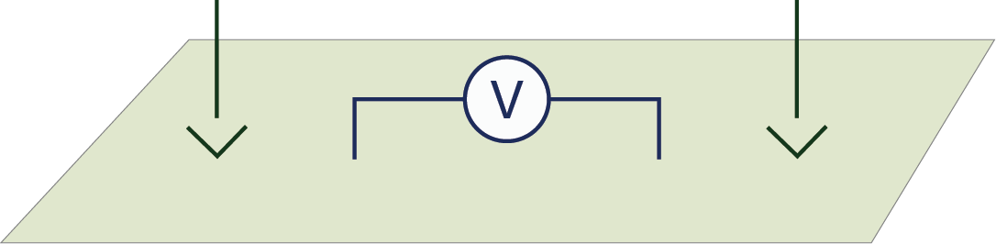
Eletrorresistividade (DC Resistivity)
Thanks to
1

Slide 2
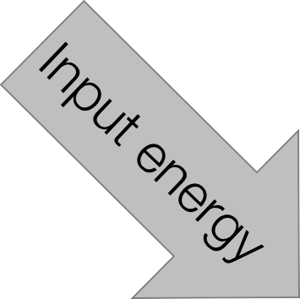
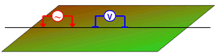
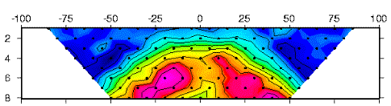
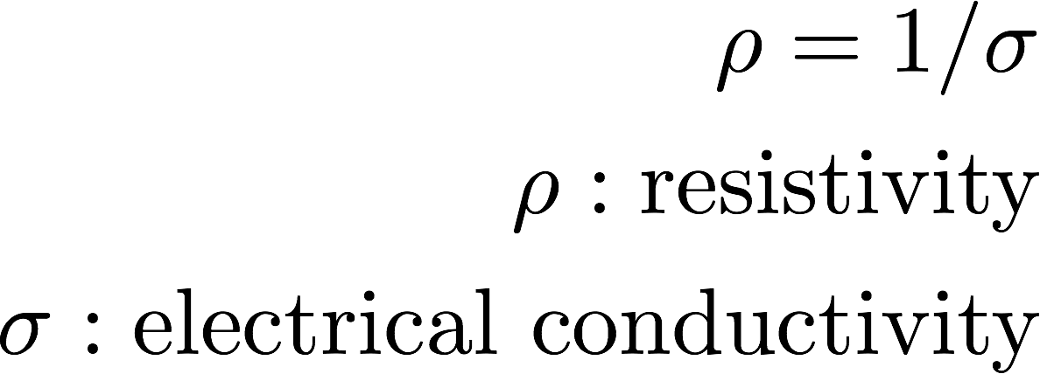

DC Resistivity Survey
Source
Data
2

Slide 3
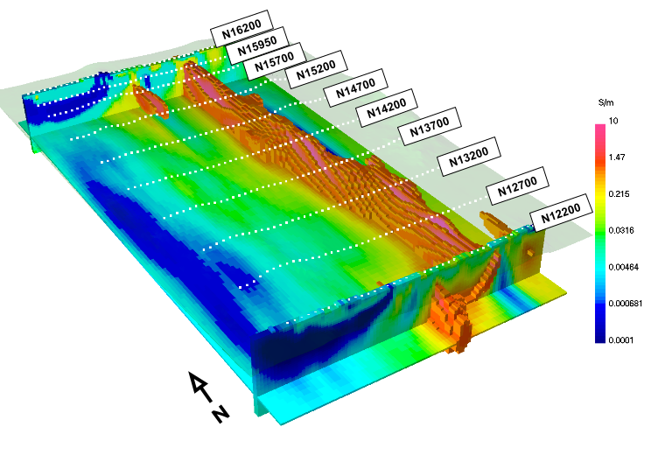
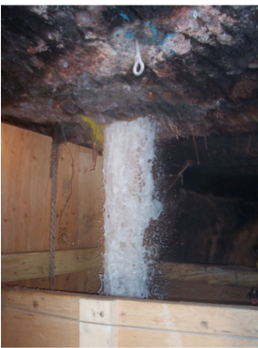
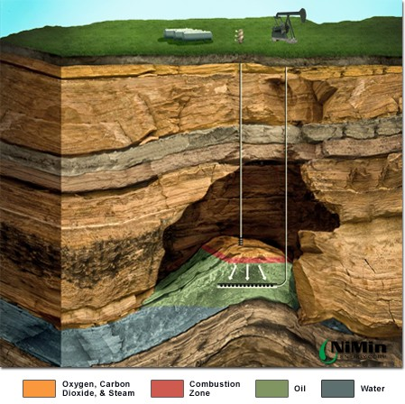
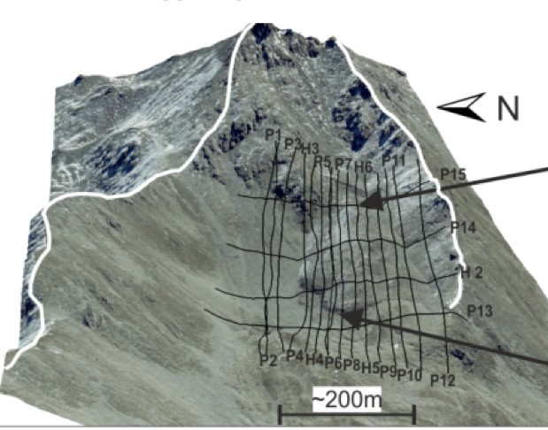
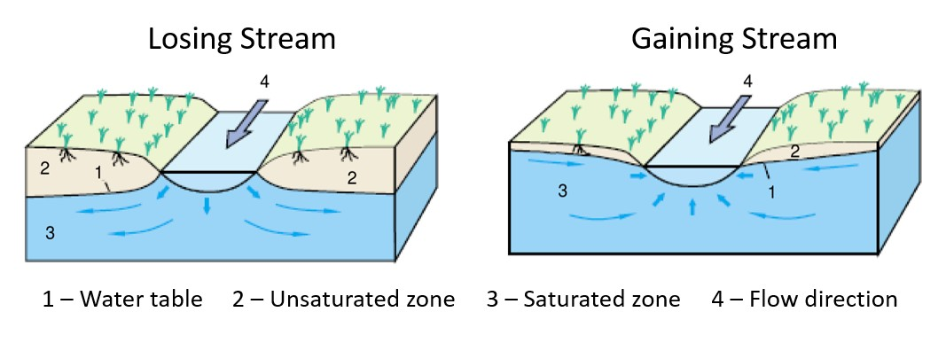
Motivation
Minerals
Water inflow in mine
Oil and Gas
Geotechnical
Groundwater
3

Slide 4
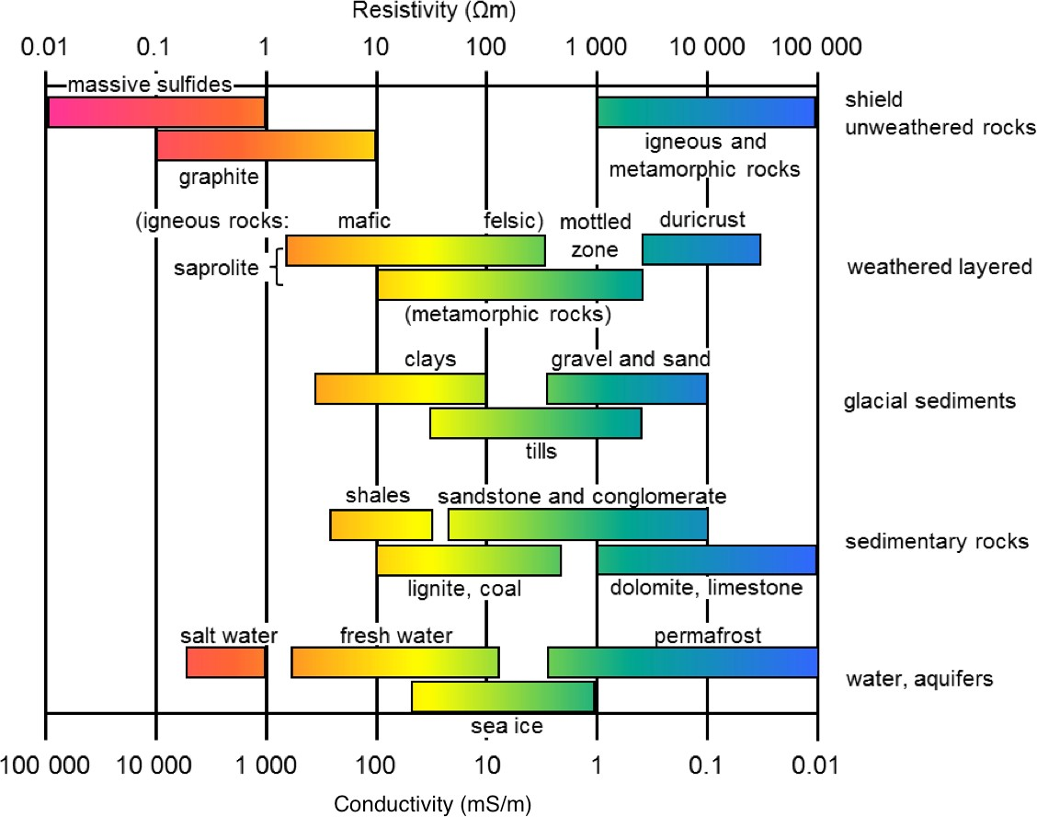
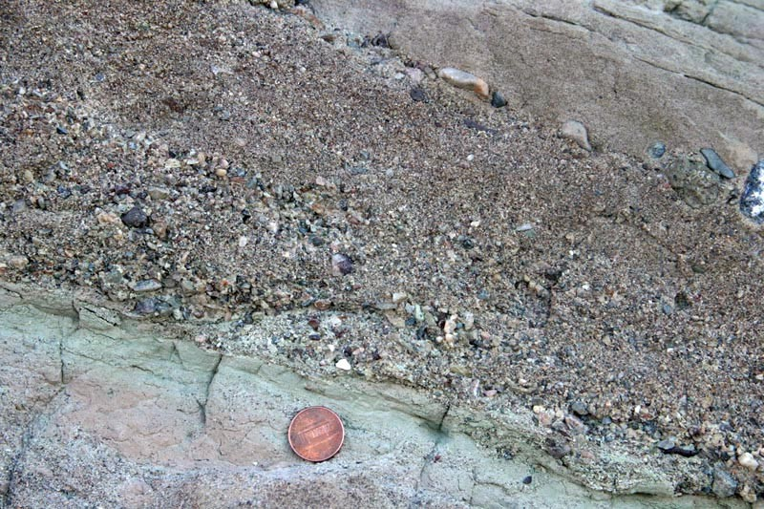
Electrical conductivity
DC resistivity is sensitive to:
σ: Conductivity [S/m]
ρ: Resistivity [Ωm]
– σ = 1/ρ
Varies over many orders of magnitude
Depends on many factors:
Rock type
Porosity
Connectivity of pores
Nature of the fluid
Metallic content of the solid matrix
4

Slide 5
Outline
Basic experiment
Currents, charges, potentials and apparent resistivities
Soundings, profiles and arrays
Data, pseudosections and inversion
Sensitivity
Survey Design
Case History – Mt Isa
Case History – Dam Monitoring
Effects of background resistivity
5

Slide 6
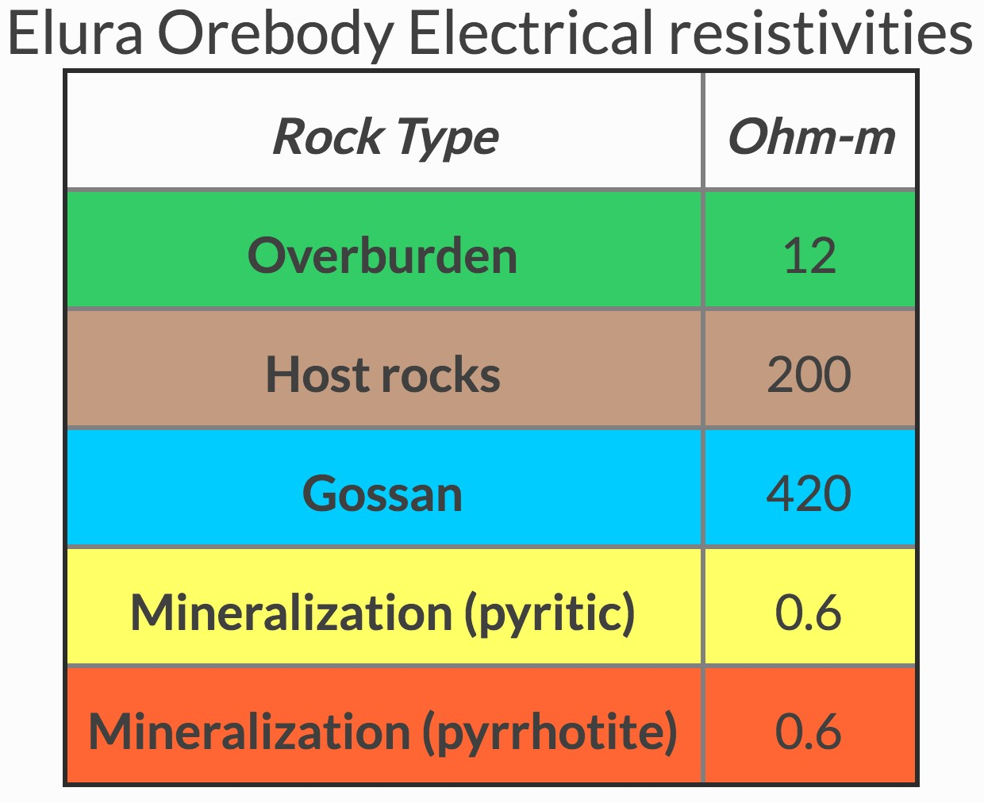
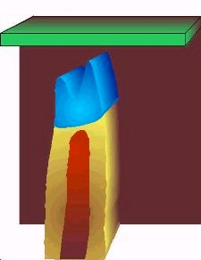
Basic Experiment
Target:
– Ore body. Mineralized regions less resistive than host
6

Slide 7
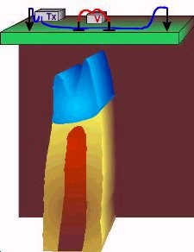
Basic Experiment
Target:
Ore body. Mineralized regions less resistive than host
Setup:
Tx: Current electrodes
Rx: Potential electrodes
7

Slide 8
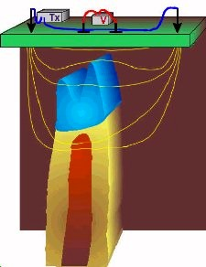
Basic Experiment
Target:
Ore body. Mineralized regions less resistive than host
Setup:
Tx: Current electrodes
Rx: Potential electrodes
Currents:
Preferentially flow through conductors
8

Slide 9

Basic Experiment
Target:
Ore body. Mineralized regions less resistive than host
Setup:
Tx: Current electrodes
Rx: Potential electrodes
Currents:
Preferentially flow through conductors
Charges:
Build up at interfaces
9

Slide 10
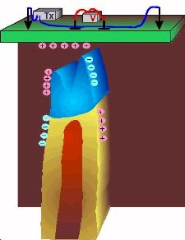
Basic Experiment
Target:
Ore body. Mineralized regions less resistive than host
Setup:
Tx: Current electrodes
Rx: Potential electrodes
Currents:
Preferentially flow through conductors
Charges:
Build up at interfaces
Potentials:
– Associated with the charges are measured at the surface
10

Slide 11
How do we obtain resistivity?

Slide 12
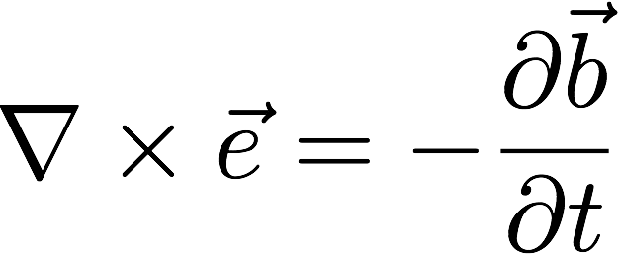

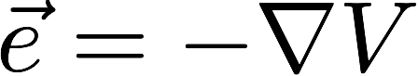
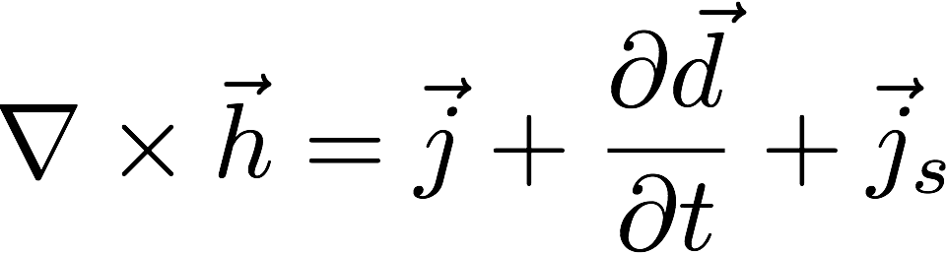
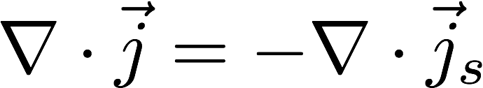
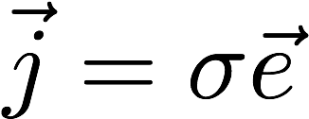
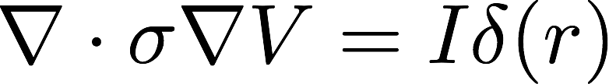
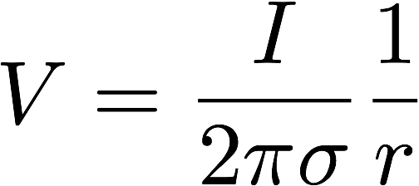
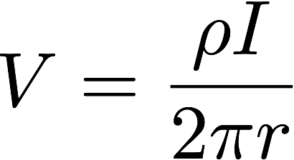
Steady State Maxwell equations
Full Steady State
Faraday
Ampere
Ohm’s Law
Put it together Potential in a
homogeneous halfspace

Slide 13
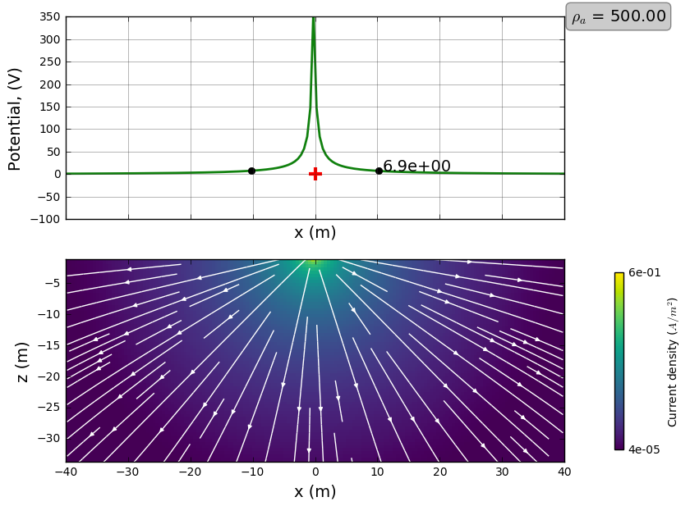
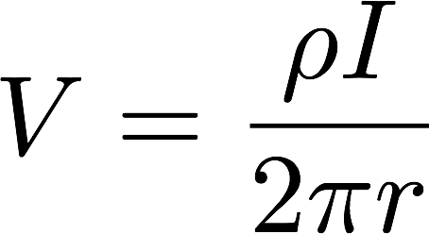
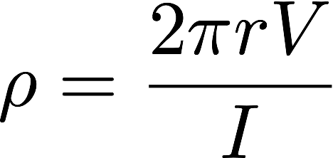
Currents and potentials: halfspace

Slide 14
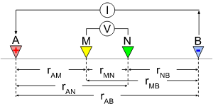
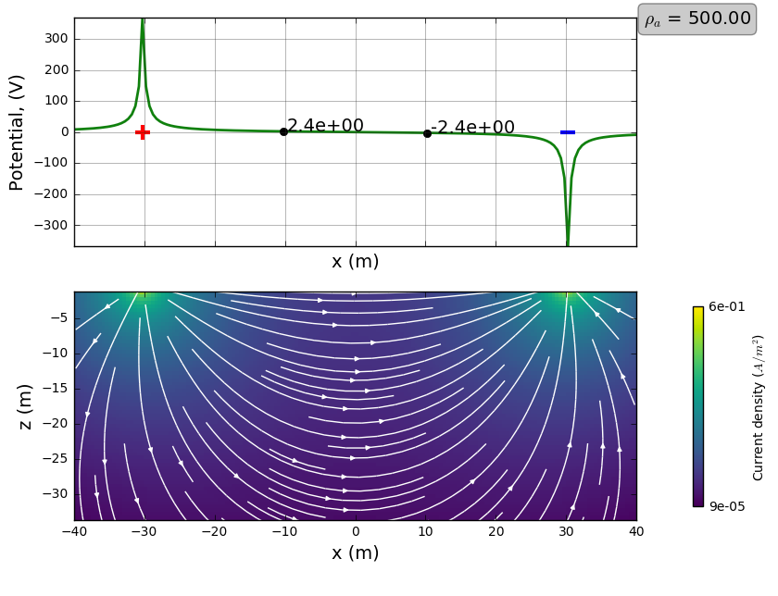
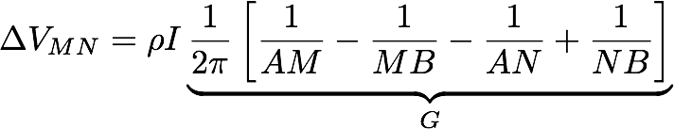
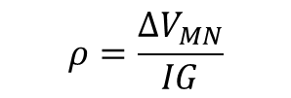
Currents and potentials: 4-electrode array
Halfspace (500 Ω𝑚)
Resistivity
$$ρ=\frac{ΔV_{MN}}{IG}$$

Slide 15
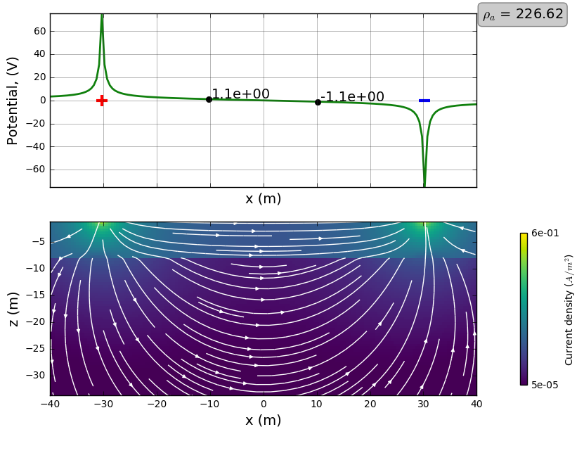
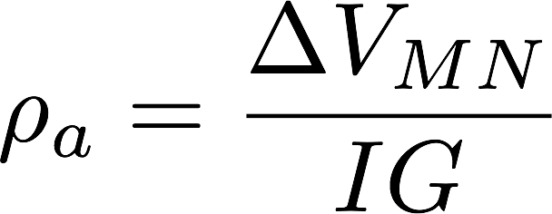
Currents and Apparent Resistivity
Conductive overburden (100 Ω𝑚)
Apparent resistivity

Slide 16
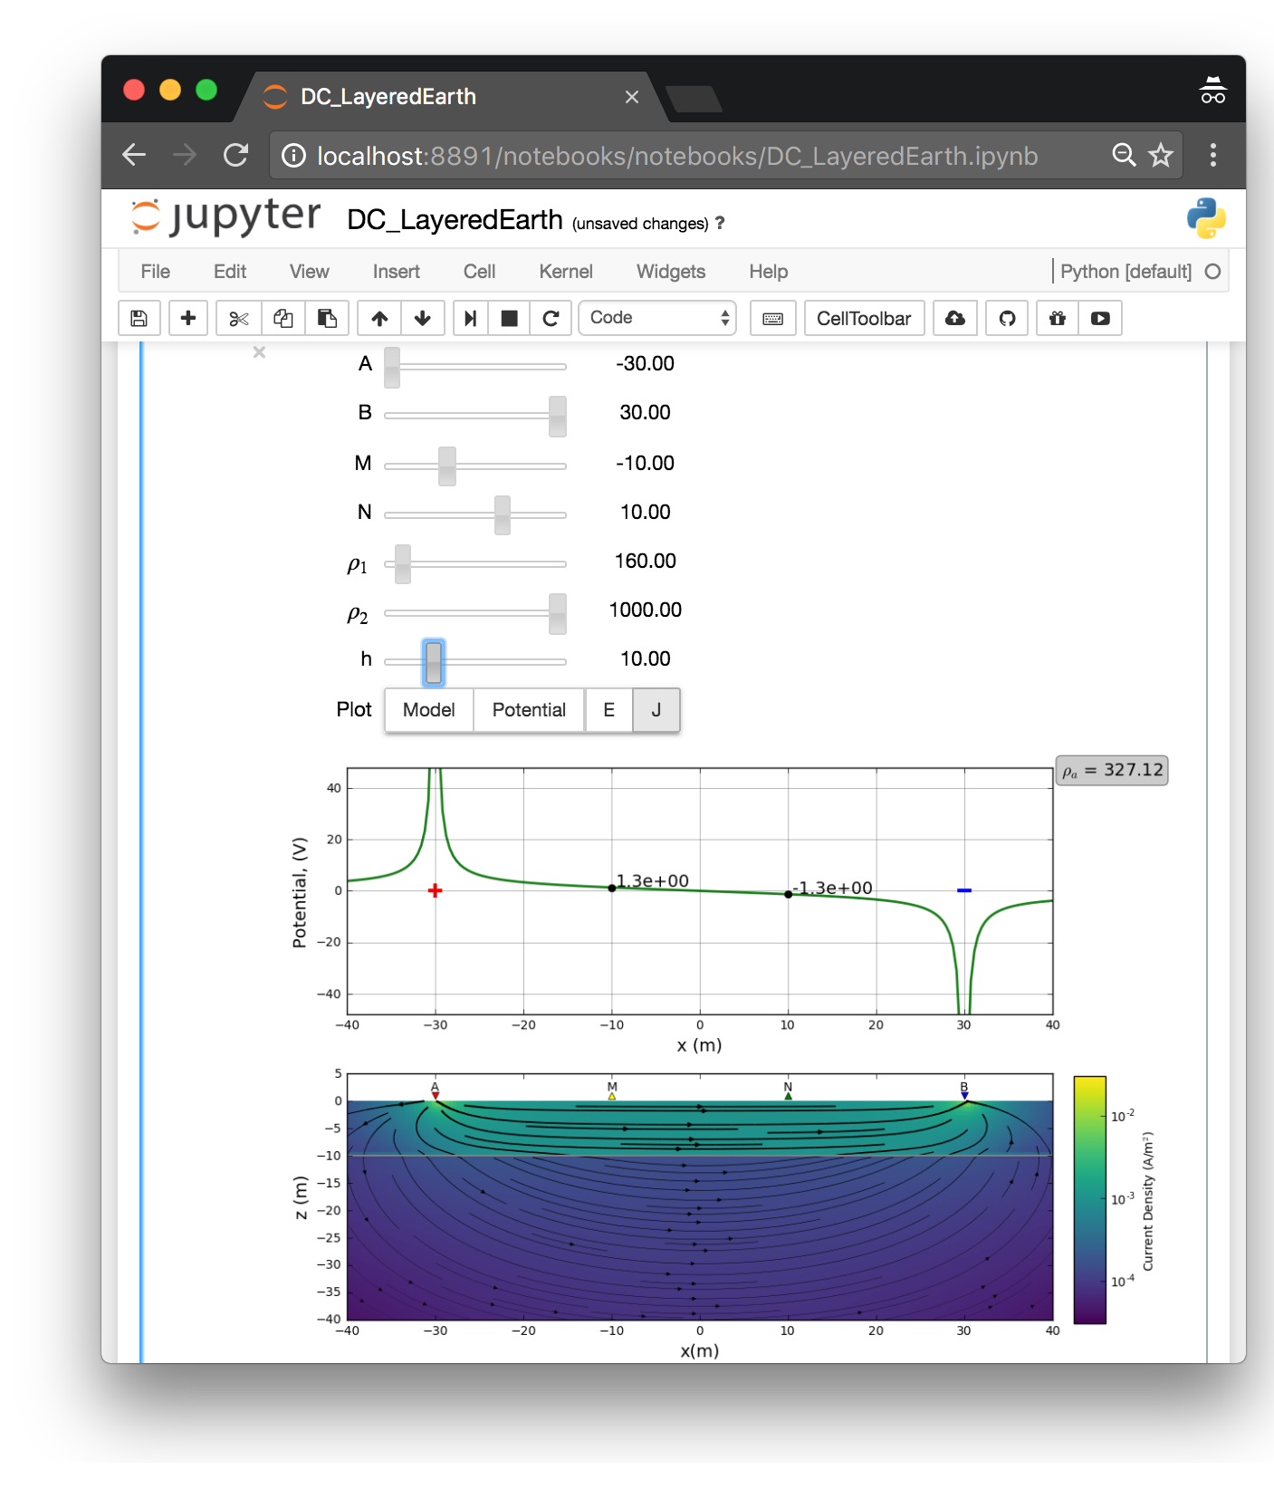
DC App
Why interactive apps?
Visualization aids understanding
Learn through interaction
ask questions and investigate
Open source:
Free to use
Welcome contributions!
http://em.geosci.xyz/apps.html
16

Slide 17
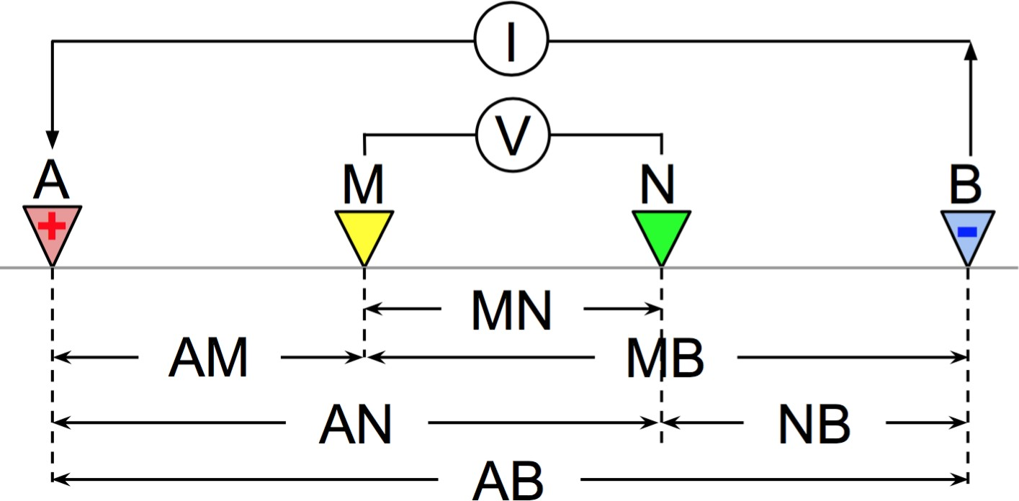
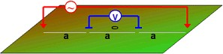
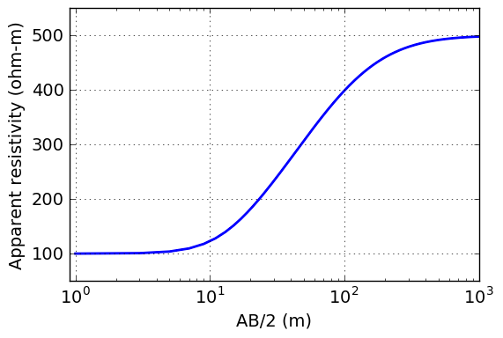
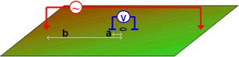
Soundings and Arrays
Geometry
4 electrode Array
Wenner
Sounding
Schlumberger

Slide 18
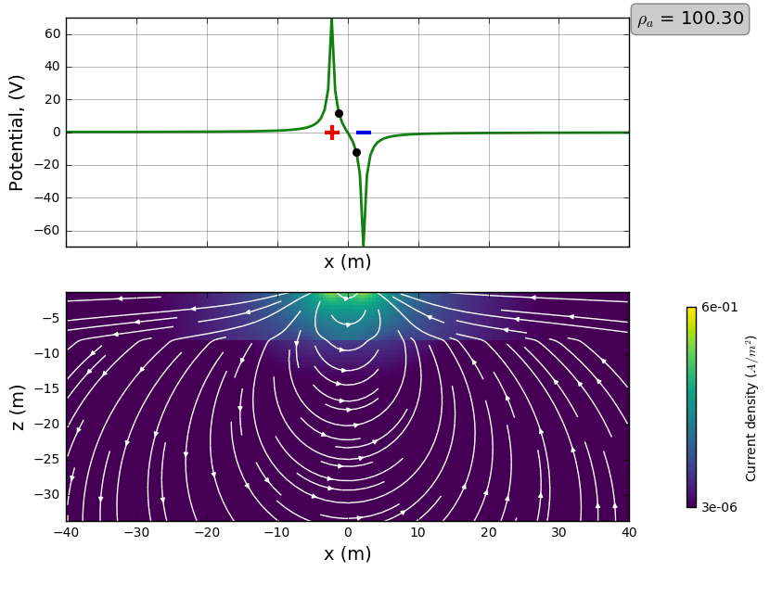
Soundings
AB/2 = 5 m
DC Sounding curve

Slide 19
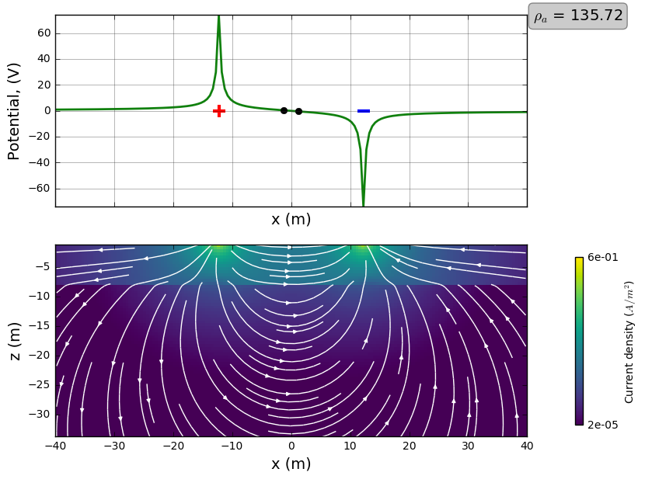
Soundings
AB/2 = 10 m
DC Sounding curve

Slide 20

Soundings
AB/2 = 30 m
DC Sounding curve

Slide 21

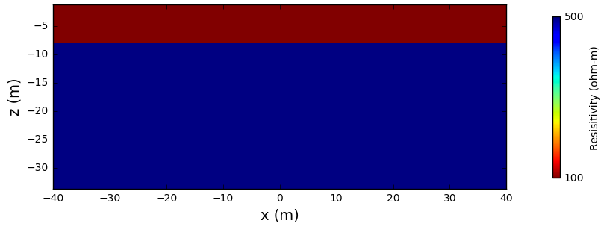
Summary: soundings
Schlumberger array
DC Sounding curve
100 Ω𝑚
500 Ω𝑚
Scale length of array must be large to see deep

Slide 22
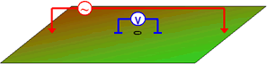


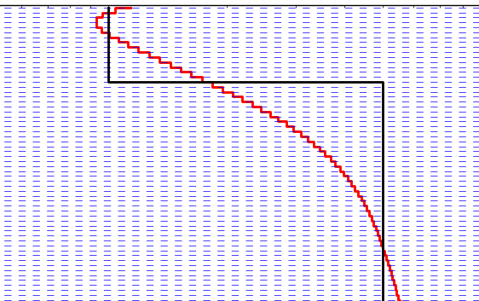

Inversion
Data
Measurements over the Earth are data.
Model
Inversion processing
Depth
Inversion estimates Earth models based upon data and prior knowledge. ₂₂
Resistivity

Slide 23
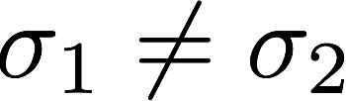
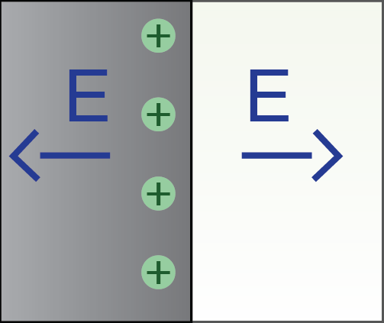
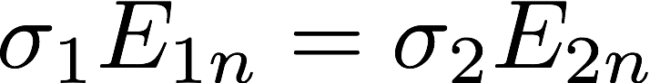
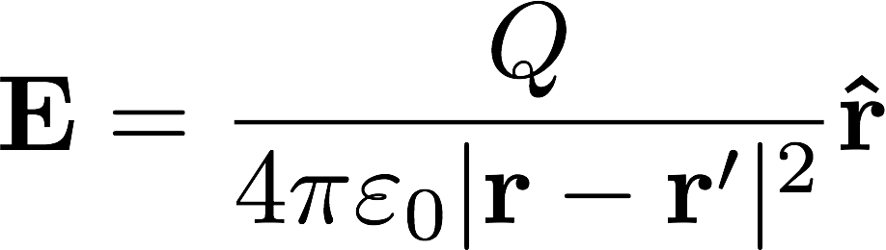
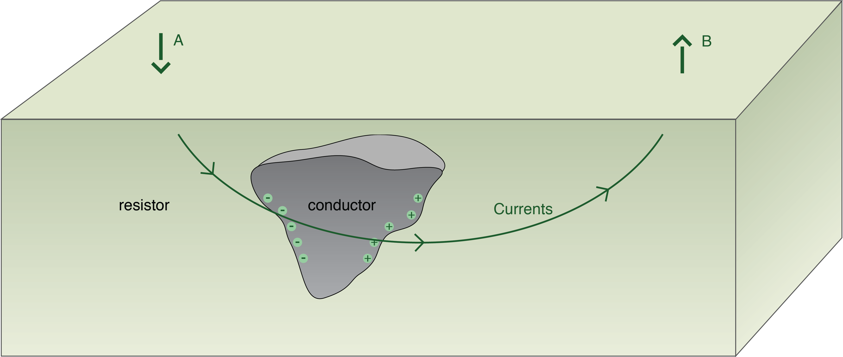
DCR for a confined body
Useful to formally bring in the concept of charges
Normal component of current density is continuous
J1n = J2n
Conductivity contrast
Electric field discontinuous
Charge build-up

Slide 24
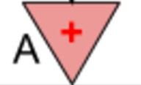





Currents, charges, and potentials
Total currents: J
Secondary currents: J_{s}
-
+
Secondary charges: Q_{s}
Secondary potential: 𝜙₎

Slide 25




Measurements of DC data: gradient array
Resistivity model 500 Ωm
1 Ωm
Potential profile
ρ* = 430
MN
ρ* = 430
MN
-
+
Secondary charges: Q_{s}
Secondary currents: J_{s}

Slide 26


Measurements of DC data: gradient array
Resistivity model 500 Ωm
1 Ωm
Potential profile
ρ* = 502
MN
ρ* = 502
MN
-
+
Secondary charges: Q_{s}
Secondary currents: J_{s}

Slide 27

Measurements of DC data: gradient array
Resistivity model 500 Ωm
1 Ωm
Potential profile
ρ* = 502 ρ* = 430 ρ* = 502
MN MN MN
- +
ρ* = 502 ρ* = 430 ρ* = 502
MN MN MN
Secondary charges: Q_{s}
Secondary currents: J_{s}

Slide 28



Profiling
Fixed geometry: Move laterally
Short offset, a=4m A B MN
Short offset: a = 4 m
Long offset, a=20m
A B
M
a
N
a a
Long offset: a = 20 m
500 Ωm
1 Ωm
Depth of investigation depends upon offset or array length

Slide 29

Summary: Soundings and Profiles
Sounding Profiling
Expand
Translate

Slide 30




Basic Survey Setups
Wenner
Pole-Pole
Schulmberger
Pole-Dipole
Gradient
Dipole-Dipole

Slide 31






DC resistivity data
Source (Amps)
Plotting plane
Potential (Volts)
Plotting plane
Plotting plane
_{ρ =} 2πΔV
Each data point is an apparent resistivity:
a
IG

Slide 32

Example pseudosections
1) A single buried conductive block
Pole-Dipole
• Pole-dipole; n=1,8; a=10m; N=316
32

Slide 33

Example pseudosections
2) The conductive block with geologic noise.
Pole-Dipole
• Pole-dipole; n=1,8; a=10m; N=316
32

Slide 34

Example pseudosections
3) The “UBC-GIF model”
Pole-Dipole
34

Slide 35






Inversion
Data
Measurements over the Earth are data.
?
processing
Model
Inversion estimates Earth models based upon data and prior knowledge.
35

Slide 36




Example 1: buried prism
Resistivity model Ohm7 | m Recovered resistivity Ohm7
Data with 5% Gaussian noise | Predicted data
m
Pole-dipole; n=1,8; a=10m; N=316; (α_{s}, α_{x}, α_{z})=(.001, 1.0, 1.0)

Slide 37




Example 2: prism with geologic noise
Resistivity model Ohm7 | m Recovered resistivity Ohm7
Data with 5% Gaussian noise | Predicted data
m
Pole-dipole; n=1,8; a=10m; N=316; (α_{s}, α_{x}, α_{z})=(.001, 1.0, 1.0)

Slide 38




Example 3: UBC-GIF model
Resistivity model Ohm- Need figures | m Recovered resistivity Ohm- Need figures
Data with 5% Gaussian noise Need figures | Predicted data Need figures
m
Pole-dipole; n=1,8; a=10m

Slide 39



The world is 3D
Target
Size, shape, depth
Background
Variable resistivity
Host
Water underground
Questions
Where to put currents? 2D acquisition? 3D?
Where to make measurements?
Which measurements?
Effects of topography?
Ore body
Topography
These are survey design questions
Crucial element is the sensitivity

Slide 40
Sensitivity

Slide 41

Sensitivity Function
Is the measured potential sensitive
to the target?
Quantified by the sensitivity
Od
tt = =
change in data
Op change in model
Collect the data that are sensitive to the target
Need to excite the target
Need to have sensor close to the target

Slide 42

Exciting the target
Resistivity model
Total currents: J
Secondary currents: J_{s}
Secondary charges: Q_{s}
Secondary potential: ϕ₎
-
+

Slide 43



Measurements
Resistivity model
Secondary charges: Q_{s}
MN MN
Potential profile
MN
-
+
Secondary potential: ϕ₎
Total potential: ϕ
ρ* = 502
MN
ρ* = 430
MN
ρ* = 502
MN
MN
MN
MN

Slide 44








Coupling
Thin plate – different orientations
→ different data
Total currents: J

Slide 45




Conductive vs. Resistive Target
Conductive Target
Total currents: J
Resistive Target
Total currents: J
Secondary charges: Q_{s}
Secondary charges: Q_{s}
Q=-3.4x10⁻¹¹
Q=3.4x10⁻¹¹
Q=1.6x10⁻¹⁰
Q=-1.6x10⁻¹⁰

Slide 46


Summary: Sensitivity
Total currents: J
“Excite” the target
Drive currents to target
Need good coupling with target
Measuring a datum
Proximity to target
Electrode orientation and separation
Secondary Charges: Q
- +
Background resistivity is important
Total potential: ϕ
Secondary potential: ϕ₎

Slide 47
Survey Design: Questions
What is objective?
Layered earth (1D)
→ do a sounding
Target body (2D)
→ profile, sounding perpendicular to geology
Target body (3D)
→ need 3D coverage
What is the background resistivity?
What are the noise sources? fences, power lines, …

Slide 48




Survey Design: in general
Numerical simulation – can we see the target?
Steps:
Define a geologic model
Assign physical properties
Select a survey
Simulate with (V) and without (V_{p}) target
Best practice
Assign uncertainties to simulated data
Invert with code you will use for the field data
Signal from target
Need

Slide 49
Outline
Basic experiment
Currents, charges, potentials and apparent resistivities
Soundings, profiles and arrays
Data, pseudosections and inversion
Sensitivity
Survey Design
Case History – Mt Isa
Case History – Dam Monitoring
Effects of background resistivity

Slide 50


Mt. Isa
Mt. Isa (Cluny prospect)
Seven Steps

Slide 51

Setup
Mt. Isa (Cluny prospect)
Geologic model
Question
Can conductive units, which would be potential targets within the siltstones, be identified with DC data?

Slide 52


Properties
Geologic model
Surface topography

Slide 53


Survey and Data
Eight survey lines
Two survey configurations.
Data set #1:
Apparent resistivity, pole - dipole.
Surface topography
mS/m
Easting (m)
Easting (m)

Slide 54


Survey and Data
Eight survey lines
Two survey configurations.
Data set #2:
Apparent resistivity, dipole - pole
Surface topography
mS/m
mS/m
Easting (m) Easting (m)
Easting (m)
Easting (m)

Slide 55

Processing and interpretation
3D resistivity model
Animation

Slide 56


Synthesis
Identified a major conductor → black shale unit
Some indication of a moderate conductor
3D resistivity model
Geologic section
Resistivity section

Slide 57

Case History: Monitoring an embankment dam
Rhone river, France
Boleve and Revil., 2009

Slide 58


Physics of streaming potential
Fluid flow
Steady-state, unsaturated flow
~u = K h
~u = 0
With B.C.
K = k_{r}(S_{w}, ...)K_{s}
~u: fluid velocity [m/s]
h: hydraulic head [m]
K: hydraulic conductivity [m/s]
S_{w}: saturation
K_{s}: hydraulic conductivity at S_{w}=1
k_{r}: relative permeability

Slide 59


Physics of streaming potential
Streaming potential
Streaming currents
streaming currents
electric currents

Slide 60

Physics of streaming potential
Streaming potential
Streaming currents
streaming currents
electric currents
Measured streaming potential difference:$ — $ref

Slide 61

Setup
Embankment dam in southeast France along the Rhone River
Unconsolidated materials:
sand + gravels
Riverside impermeable layer
cemented clay and silt
Expected water seepage
leakage water collected in a ditch
Piezometers
measure water level
every ~150m
Vertical sealing
cement + bentonite
12 m height and 12cm width
Can we image the preferential seepage zone, and determine velocity?
61

Slide 62


Properties
Geologic section
Low permeability zone
Cemented clay & silt
Seal
High permeability zone
– Gravels
High electrical conductivity
– Silt and clays
Physical property table
High Q_{v}
– Cemented clay
62

Slide 63

Survey
DC survey
4 profile lines
Wenner array
SP survey (2 days)
– 2007/09/18: 1169 data
– 2007/09/19: 2076 data
63

Slide 64



Data
SP maps on two different days
A3 (riverside): negative SP anomalies
A1 and A2 (near ditch): positive SP anomalies
64

Slide 65

Processing
SP maps on two different days
Goal: recover streaming currents
data
streaming currents
r · or$ = r · ~j_{s}
conductivity
Obtain conductivity from⁶D⁵ C

Slide 66



Processing
Resistivity from DC Inversions
Goal: recover streaming currents
data
streaming currents
r · or$ = r · ~j_{s}
conductivity
Invert SP data to recover
6~_{j}6
s

Slide 67



Processing and inversion
Invert SP data to recover ~js
r · or$ = r · ~j_{s}
is a vector
Depth weighting (~1/z³) is used (similar to magnetic inversion)
~_{js}
SP data
Recovered streaming current (magnitude)
67

Slide 68


Processing and interpretation
How do we obtain seepage velocity, ~u ? ~_{js} ~u = Q_{v}
Recovered streaming current (magnitude) | Q_{v} vs. k
How do we get hydraulic permeability6,8k?

Slide 69


Interpretation and Synthesis
How do we obtain seepage velocity, ~u ? |  | ~u = | ~_{js} Q_{v}
Perm. test | Recovered streaming current (magnitude)
Fluid velocity: 3x10⁻³ m/s Flow rate: 3 litres /s |  |  |  | 69

Slide 70
Outline
Basic experiment
Currents, charges, potentials and apparent resistivities
Soundings, profiles and arrays
Data, pseudosections and inversion
Sensitivity
Survey Design
DC app
Case History – Mt Isa
Effects of background resistivity

Slide 71

Effects of background resistivity
Resistivity models (thin resistive layer)
500 Ωm
1 Ωm
Currents and measured data at MN
ρ* = 430 Ωm
M N

Slide 72



Effects of background resistivity
Resistivity models (thin resistive layer)
500 Ωm
1 Ωm
10⁶ Ωm
Currents and measured data at MN
ρ* = 430 Ωm ρ* = 1652 Ωm
M N M N

Slide 73




Effects of background resistivity
Resistivity models (thin resistive layer)
500 Ωm
1 Ωm
10⁶ Ωm
Currents and measured data at MN
ρ* = 430 Ωm | ρ* = 1652 Ωm | ρ* = 1654 Ωm
M N | M N | M N

Slide 74





Effects of background resistivity
Resistivity models (thin conductive layer)
500 Ωm
1 Ωm
1 Ωm
Currents and measured data at MN
ρ* = 430 Ωm ρ* = 47 Ωm
M N M N
ρ* = 47 Ωm
M N

Slide 75

End of DCR
Next up
Lunch: Play with apps

